Slide 1


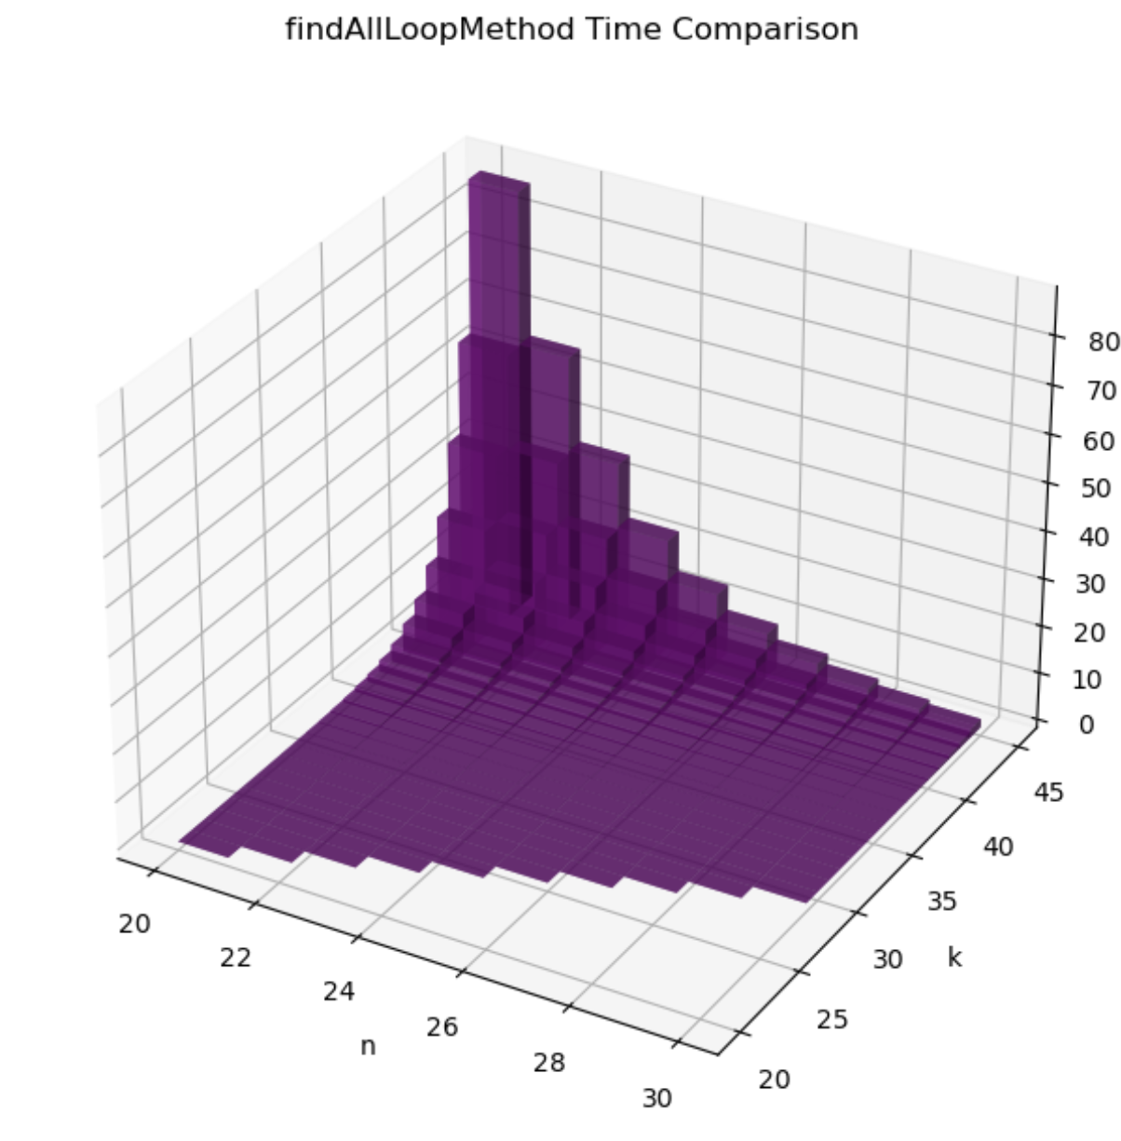
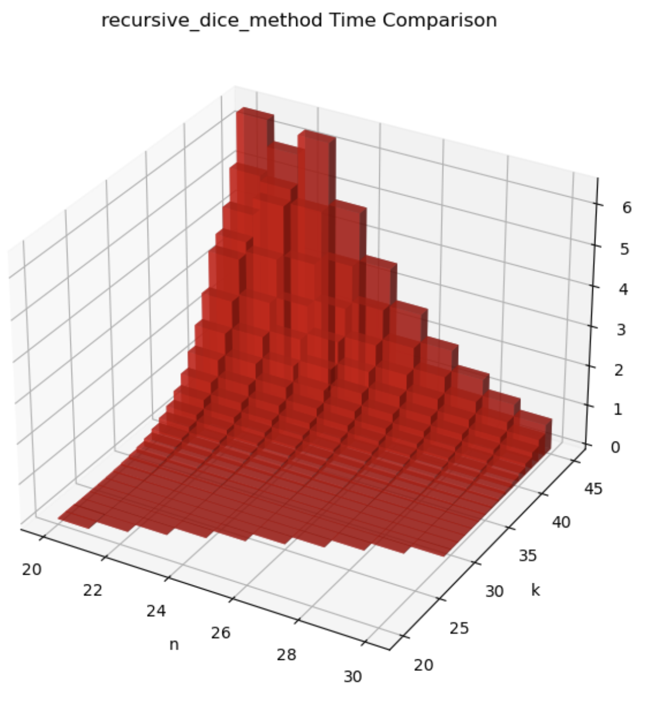
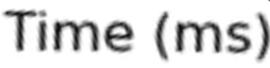
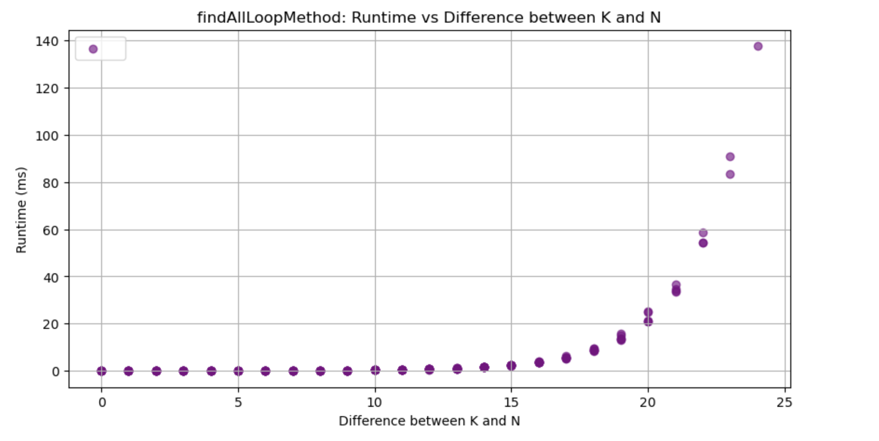
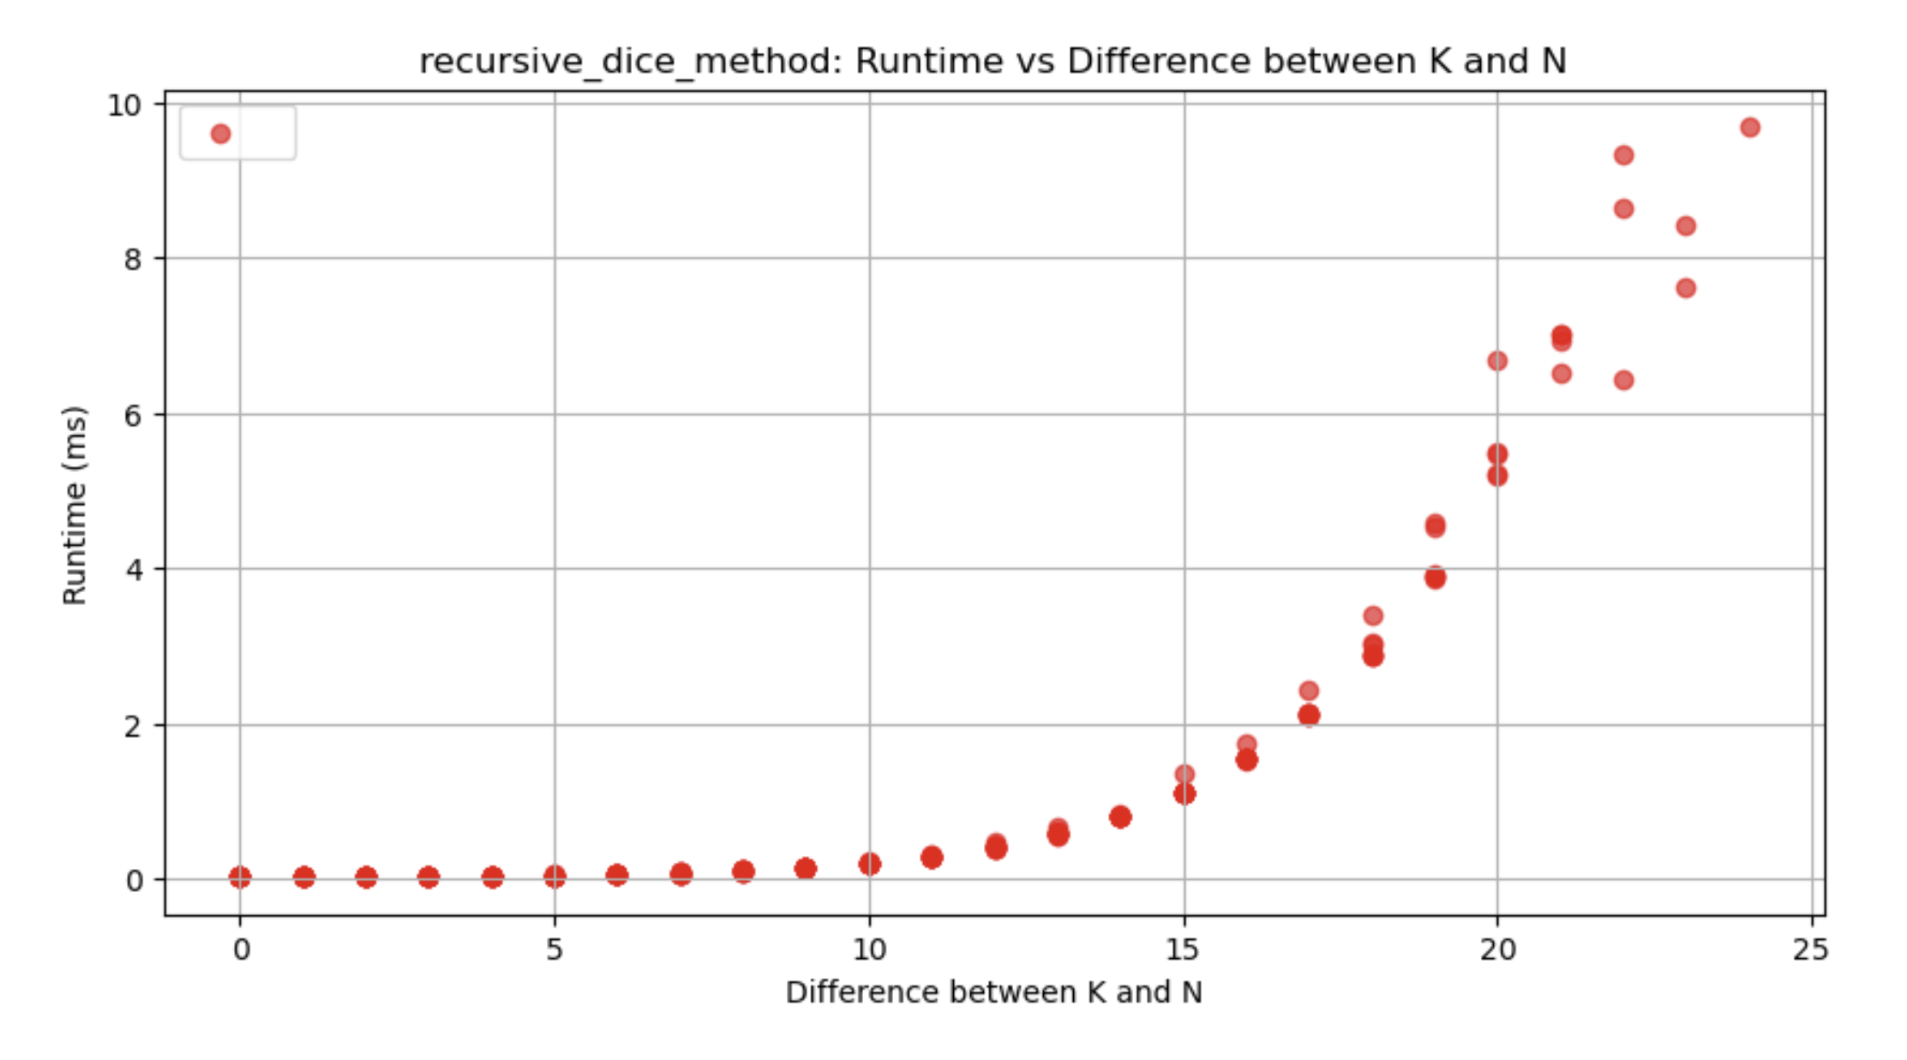
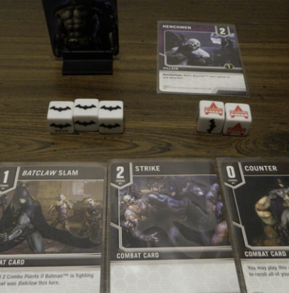

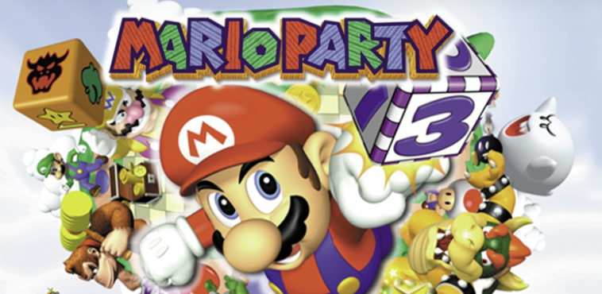
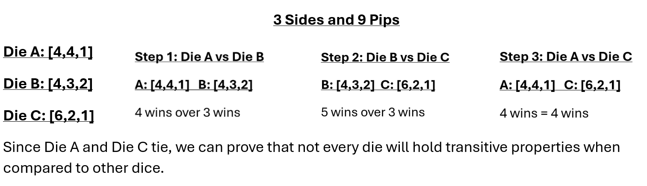
Analysis of Optimal Die Configurations
Mary Kait Heeren, Dr. Jeremy Becnel
Department of Computer Science, Stephen F. Austin State University, Nacogdoches, Texas
Abstract
Pseudocode
Algorithm Comparison
In this project, we explore algorithms for generating die configurations. Distinct algorithms are developed that accept as input the number of sides for a die and the total number of pips across all sides of the die. From this input, the algorithms generate all possible die configurations. The efficiency of the algorithms is compared.
#1 – Combinatorial Approach using DFS
Function findAllLoopMethod(n, k):
Initialize start_dice = [k-n+1] followed by n-1 ones
Initialize process_dice as a stack containing start_dice
Initialize all_dice as a list containing start_dice
While process_dice is not empty:
Pop the next die configuration (d) from process_dice
Generate new_dice by moving pip on d
For each die in new_dice:
If die is not in all_dice:
Append die to process_dice and all_dice
Return the size of all_dice
Function: move_pip(dice):
Initialize new_dice as empty list
For each side i of dice (except the last):
Initialize j as i+1
While j < sides and dice[j] == dice[i] - 1:
Increment j
If dice[i] >= dice[j] + 2:
Create a copy of dice, move pip from i to j
Append the modified die configuration to new_dice
Return new_dice
I conducted an analysis comparing the time complexities of various algorithms by measuring their execution time in milliseconds. The results were then visualized through graphs, providing a clear representation of how the time complexity of each algorithm varied.
After analyzing the time complexities, it is apparent that the recursive solution is significantly more efficient at generating the dice than the combinatorial approach. This is likely due to the use/annotation of more data structures in the combinatorial method.
Introduction/Background
Definition. Given two dice A and B with the same number of sides, a die A is said to win over another die B if given every pairing of sides (a,b) where a is from A and b is from B, the majority of the pairing satisfy a > b.
Given a dice with 3 sides and 9 pips to divide over the sides. We can generate the possible combinations.
[5,3,1],[4,3,2],[6,2,1]
Therefore, when compared…
[5,3,1] & [4,3,2]: TIE
[4,3,2] & [6,2,1]: [4,3,2] wins
[5,3,1] & [6,2,1]: TIE
Games that use unique dice that dictate the
direction of the game.
Mino Dice
Mario Party
Batman: Arkham Chronicles
#2 - Recursive Approach
Function: die_gen_recusive(n,k, previousPip):
If n == 1, return a list with k as the only element.
Otherwise:
Set low = ceil(pips / sides) and high = min(previousPip, pips - sides + 1).
Initialize dice as an empty list.
For each firstPip from low to high:
Recursively generate dice for sides - 1 and pips - firstPip with firstPip as previousPip.
Prepend firstPip to each resulting dice and add it to dice.
Return the list dice.
Function: recursive_dice_count(sides, pips, previousPip):
If sides == pips or sides + 1 == pips, return 1.
Otherwise:
Set low = ceil(pips / sides) and high = min(previousPip, pips - sides + 1).
Initialize sum = 0.
For each firstPip from low to high:
Add the result of recursively calling recursive_dice_v2 for sides - 1 and pips - firstPip with firstPip as previousPip to sum.
Return sum.
A Look at Transitivity
Conclusion
A relation is transitive whenever one element is related to a second element, and that second element is related to a third element, then the first element is also related to the third element.
In terms of dice:
If Die A wins over Die B, and Die B wins over Die C, then for transitivity to hold, Die A should also win over Die C.
Disproval:
Through the development of two methods that generate all possible combinations of dice given n sides and k pips, as well as using timing (in milliseconds) to compare the algorithms, it is apparent that dice hold interesting capabilities. Overall, this research highlights the complexity of dice analysis that range from applications in programming to combinatorics. These results suggest an unconventional nature of dice and open the door for further investigation into the behavior of dice and their application in different environments.
Future Work
Future steps could include combining the knowledge of dice combinatorics explored thus far and a machine learning model to facilitate an application version of various board games.
Contact
Acknowledgements
References
Mary Kait Heeren
Department of Computer Science
P.O. Box 9837, SFA Station Nacogdoches, Texas 75962
heerenmk@jacks.sfasu.edu
This research was supported by the College of Sciences and Mathematics as part of the Undergraduate Research Experience at Stephen F. Austin State University. I’d like to extend a thank you to Stephen F. Austin State University and Jeremy Becnel for providing an opportunity to get involved in a Research Experience, as it has been an insightful and rewarding process.
Thank you to the Computer Science department for the workspace and the equipment used throughout the entirety of the project.
A special thanks to Dr. Nicolas Long for the concept of dice combinatorics that this project is based on.
1. Jupyter Notebook (Project Jupyter | Home)
2. Geeks for Geeks (Transitive Relations: Definition, Properties, and Examples (geeksforgeeks.org))
3. Github Repository (SFA-CS/DiceProblem)

